Slide 1

Outland Adventures Database Project
Milestone 4 Presentation
Red Team
Tiffany Davidson | Matthew Rozendaal | Mickelly Audam

Slide 2

Group Introduction
We are the Red Team, and we chose the Outland Adventures case study.
Our team designed and implemented a relational database to support trip bookings, equipment rentals and purchases, customer accounts, and reporting needs.

Slide 3

Case Study Overview
Outland Adventures is a guided hiking and camping company operating trips in Africa, Asia, and Southern Europe.
The business required a system to manage customers, trips, equipment, and data driven business decisions.

Slide 4

Business Questions Addressed
Are enough customers purchasing equipment to justify sales?
Are any regions showing a downward trend in bookings?
Which inventory items are over five years old and may need replacement?

Slide 5

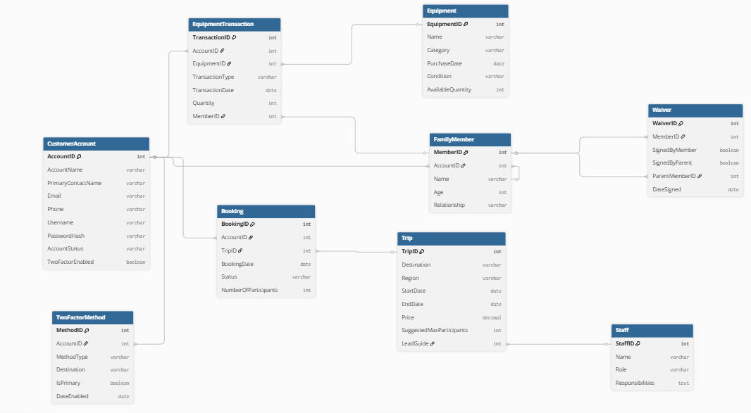
Finalized ERD

Slide 6

Report 1: Equipment Profit and Rental Performance
Purpose: Evaluate whether selling equipment is profitable.
Uses purchase cost, sale price, rental price, and transaction history.
Outputs include sale profit, rental revenue, and rental usage counts.

Slide 7

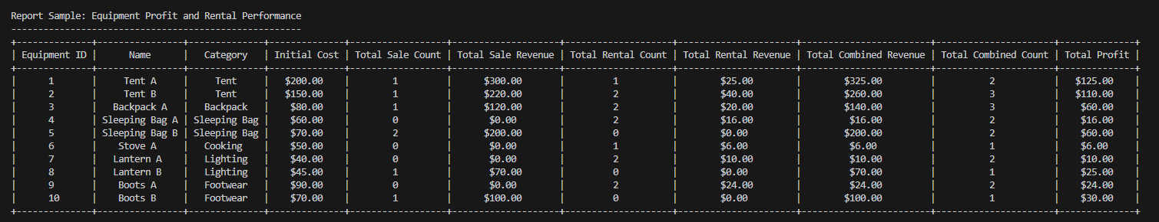
Sample Report Output: Equipment Profit & Rental

Slide 8

Report 2: Equipment Age and Inventory Status
Purpose: Identify equipment older than five years.
Uses purchase date and current date to calculate age.
Flags inventory as over or under five years old.

Slide 9

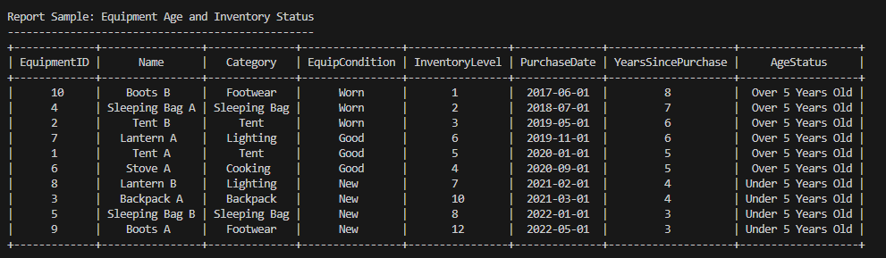
Sample Report Output: Equipment Age and Inventory Status

Slide 10

Report 3: Booking Trends by Region
Purpose: Analyze bookings across Africa, Asia, and Southern Europe.
Helps identify regions with declining or growing customer interest.

Slide 11

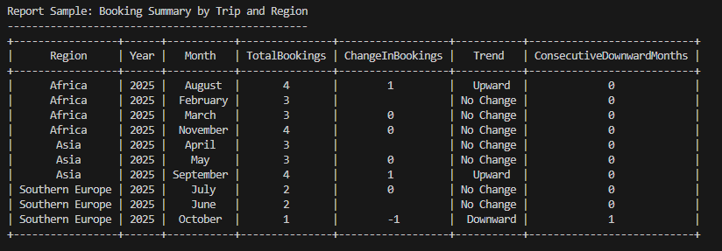
Sample Report Output: Booking Trends

Slide 12

Key Assumptions
Trips are limited to three regions.
All customers use the ecommerce platform.
Equipment condition is stored as descriptive text.

Slide 13

Conclusion
The database supports operational tracking and business decision-making.
Reporting provides insight into equipment profitability, inventory age, and booking trends.
The system is scalable and ready for future growth.

